Slide 1
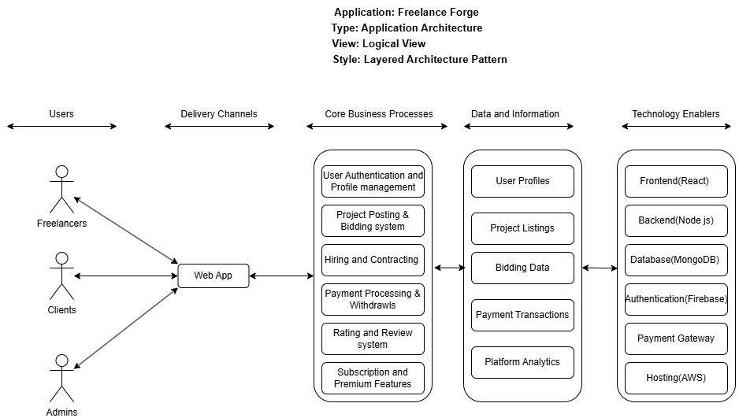

Slide 2
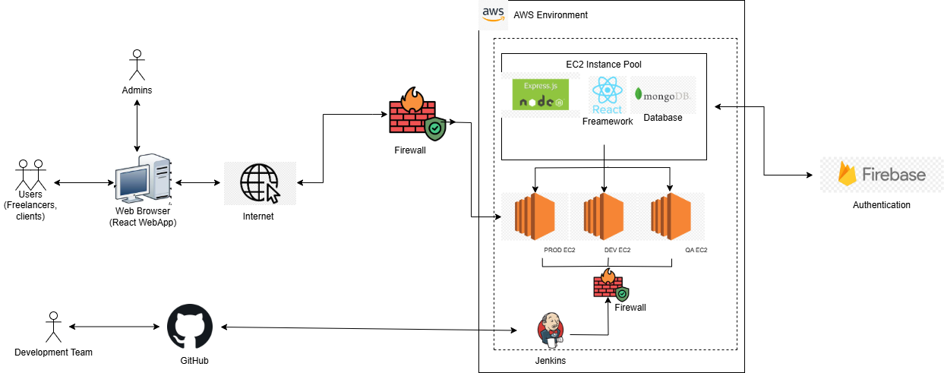
Application: Freelance Forge Type: Application Architecture View: Process View Style: Client Server Pattern

